Slide 1
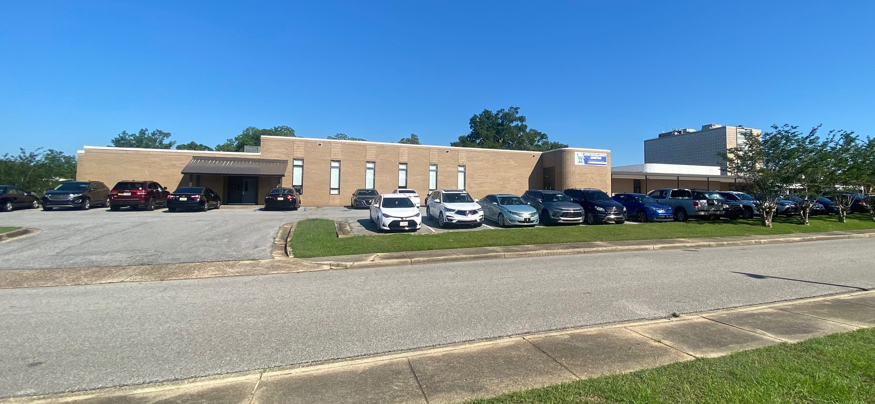
Ozanam Charitable Pharmacy, Inc.
A Medication Safety Net for Uninsured Individuals.

Slide 2
Serving Mobile, Baldwin, Escambia and Washington Counties in Alabama.
Licensed Pharmacists
Opened five days per week
Generic and Named Brand Prescription Drugs available.

Slide 3
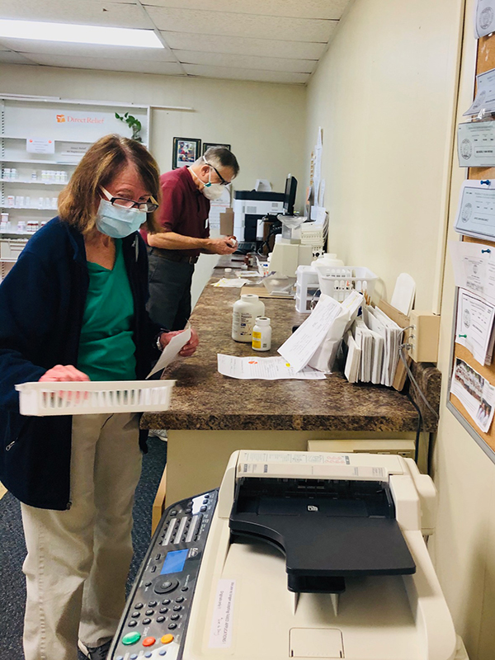
About Us
The over 27-year-old Charitable Pharmacy's primary mission is to provide affordable and appropriate pharmacy services* and coordinate access to health care for vulnerable people** in our community. *Pharmacy Services: Medicines and necessary services to ensure optimum clinical outcomes. **Vulnerable: Those living at or below 200% of the Federal Poverty Level who are uninsured or underinsured for prescription medications.
Ozanam Charitable Pharmacy dispenses prescription medication to over 1107 patients across a four-county service, including Mobile, Baldwin, Washington, and Escambia counties in lower Alabama.
The Pharmacy dispensed nearly 15,000 prescriptions with a retail value of over $2.4 million, and all of our services are free to adult individuals who qualify based on household income. For example, a household of three making $54,000 would be eligible for our services.

Slide 4
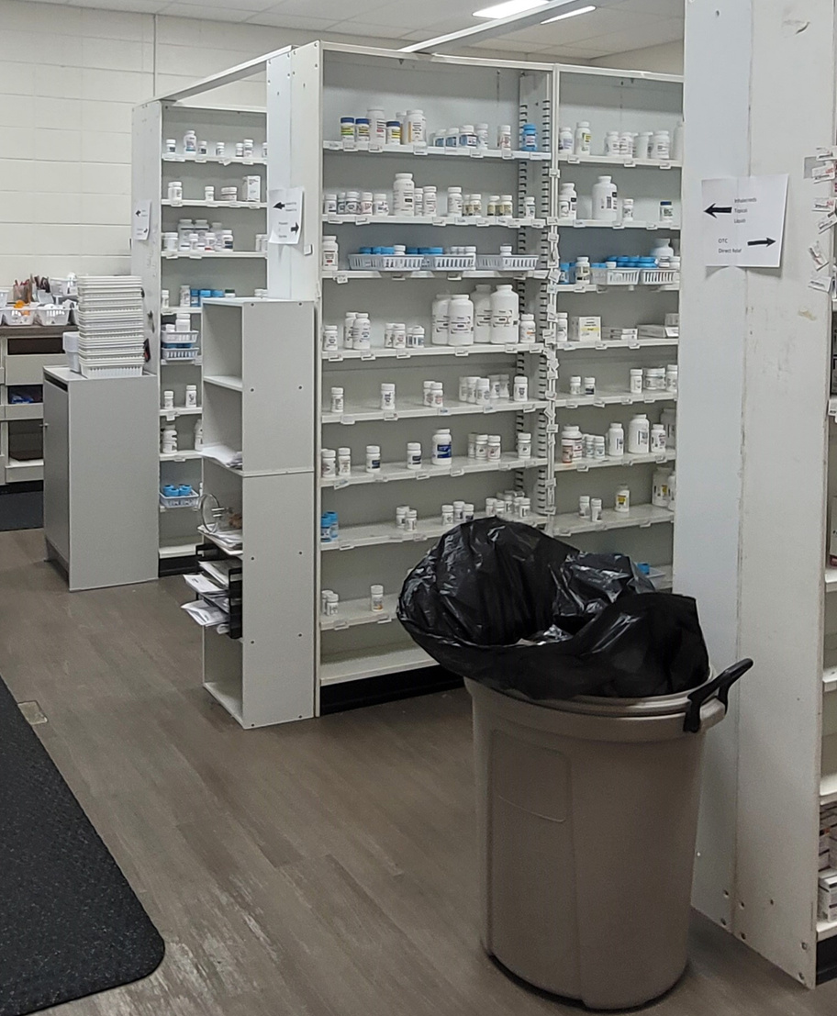
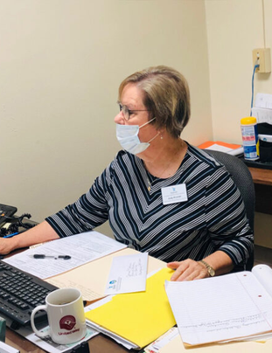
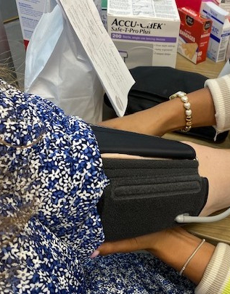
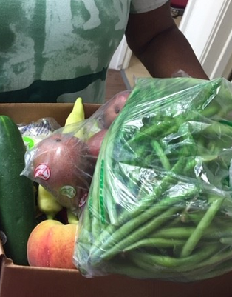
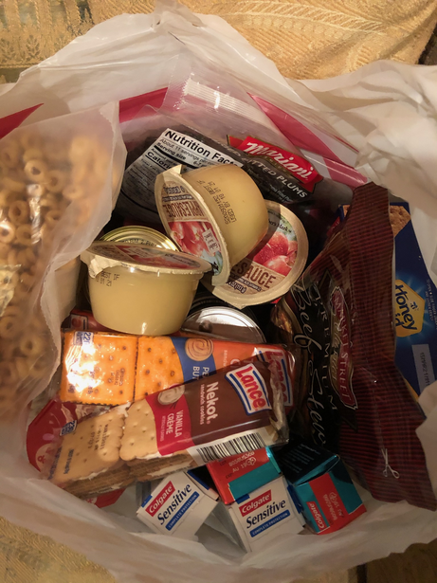
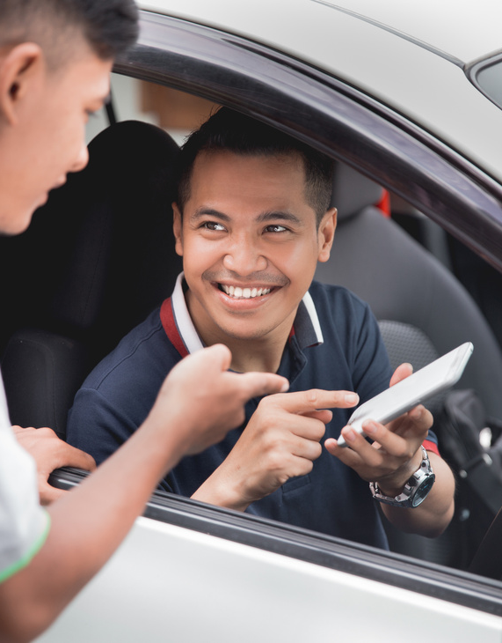
Pharmacy Services
Simply An Essential Part of meeting the patients' needs
Dispensing Licensed Pharmacy
Patient Assistance Program/SenioRX
Medication Therapy Management
Nutrition Rx - A Fresh Produce Program
Homeless Care Bags Program
Uber Health Rides

Slide 6
We purchase over $90,000 in Generic Medication
Retail pharmacy returns
Damaged packaging
Overstock
Short-dates
Purchasing discounts

Slide 7
National Partner Safety Net Organizations
Dispensary of Hope
Uninsured, ≤ 300%FPL
No Fees
Safety-Net Support:
Short-dated, overstock drugs
Medical supplies
Bulk Replenishment:
Eli Lilly insulin, Synthroid
Entresto, Invokana, Xarelto
Annual audits
Uninsured, Underinsured
≤ 300%FPL, No Fees
Safety-Net Support:
Short-dated, overstock drugs
Medical supplies

Slide 8
2023-24 Generic Meds Stats
962
11,862
$535,193.57
Mobile County Patients
Number of Prescriptions
Retail Value
29
709
$18,110.65
Washington County Patients
Number of Prescriptions
Retail Value
51
904
$31,246.13
Escambia County Patients
Number of Prescriptions
Retail Value
65
709
$46,261.23
Baldwin County Patients
Number of Prescriptions
Retail Value

Slide 9
2023-24 Brand Named Meds Stats
194
856
$1,536,302
Mobile County Patients
Number of Prescriptions
Retail Value
2
4
$8,862
Washington County Patients
Number of Prescriptions
Retail Value
27
81
$127,344
Escambia County Patients
Number of Prescriptions
Retail Value
21
51
$119,425
Baldwin County Patients
Number of Prescriptions
Retail Value

Slide 10
Our New Facility
Ozanam Charitable Pharmacy moved into a newly renovated 4600-square-foot facility on April 29, 2024. The new facility has a commercial refrigerator for fresh produce and a state-of-the-art temperature-controlled refrigerator for insulins and vaccines.

Slide 11
“I have been a patient of Ozanam for many years. I recently reconnected to its services after moving back to the area. I became seriously ill and needed to see my Primary Doctor over 40 miles away. I had no transportation and was connected to the Uber Health Rides program there. I was granted an Uber ride, which transported me to my Primary Doctor, who gave me numerous prescriptions. Ozanam filled it all at no charge. My blood pressure significantly improved within a few hours of taking my medications, and other indicators are stabilizing. Without transportation, I would not have been able to get to my doctor's prescription appointment. Without the help of Ozanam, I would not have been able to purchase my medication. Also, I have qualified to receive a box of fresh fruits and vegetables each month.”
Thanks so much to everyone. YOU ARE AWESOME!
What Our Patients Says
“I give Ozanam 5 stars for all their services. Without their help, I would not be able to afford my medication. The harvest box is also a great blessing.”
Mr. Albert, Mobile County
Ms. Angela, Eight Mile, Alabama

Slide 12
Visit our new facility
Pharmacy Address
2424 Gordon Smith Dr.
Mobile, Alabama 36617
Phone Number
251-432-4111
Email Address
info@ozanampharmacy.org
website: ozanampharmacy.org

